Slide 1
PAS Data Acquisition System

Slide 2
RT
Despite the fact that we will be targeting a Windows OS, building this like a RT system – Host will be main interface where data will be entered and viewed, values being passed between the host and the target through shared variables
No events on the target VIs – all monitoring is done through polling

Slide 3
Low Frequency IO
Analog and digital assembled through tasks
  Scaled using MAX
    Thermistor (ON-930-44006 ):
      R1 =
      Vsource =
      A = 2.7277775127E-3
      B = 2.6869922733E-4
      C = 6.1730361081E-7
    RH:

Slide 4
High Frequency AI
S-series cards allow:
  Phase coherence (not obtainable using cards with single A/D converter)
  High sampling frequency – 250 kS/s/ch

Slide 5
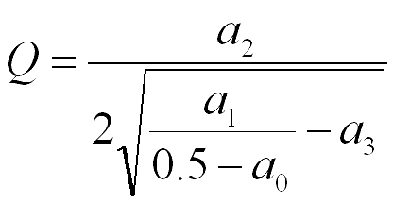
Analysis
Speaker data:
  Send out top hat with specific bandwidth centered about the previous f0
  In the band, use the Levenberg-Marquardt routine for fitting a line to the microphone data
  Get the best fit parameters and use these to determine the Q of the cavity
  f0 will be the 3rd of the best fit parameters returned

Slide 6


